Slide 1
RMAL Parent Rep Orientation and Q & A

Slide 2
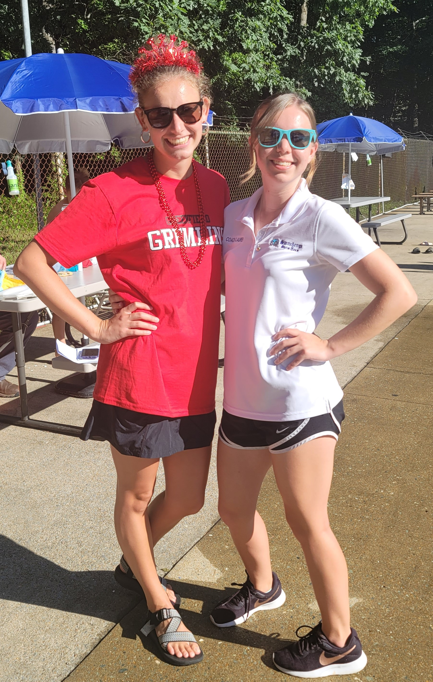
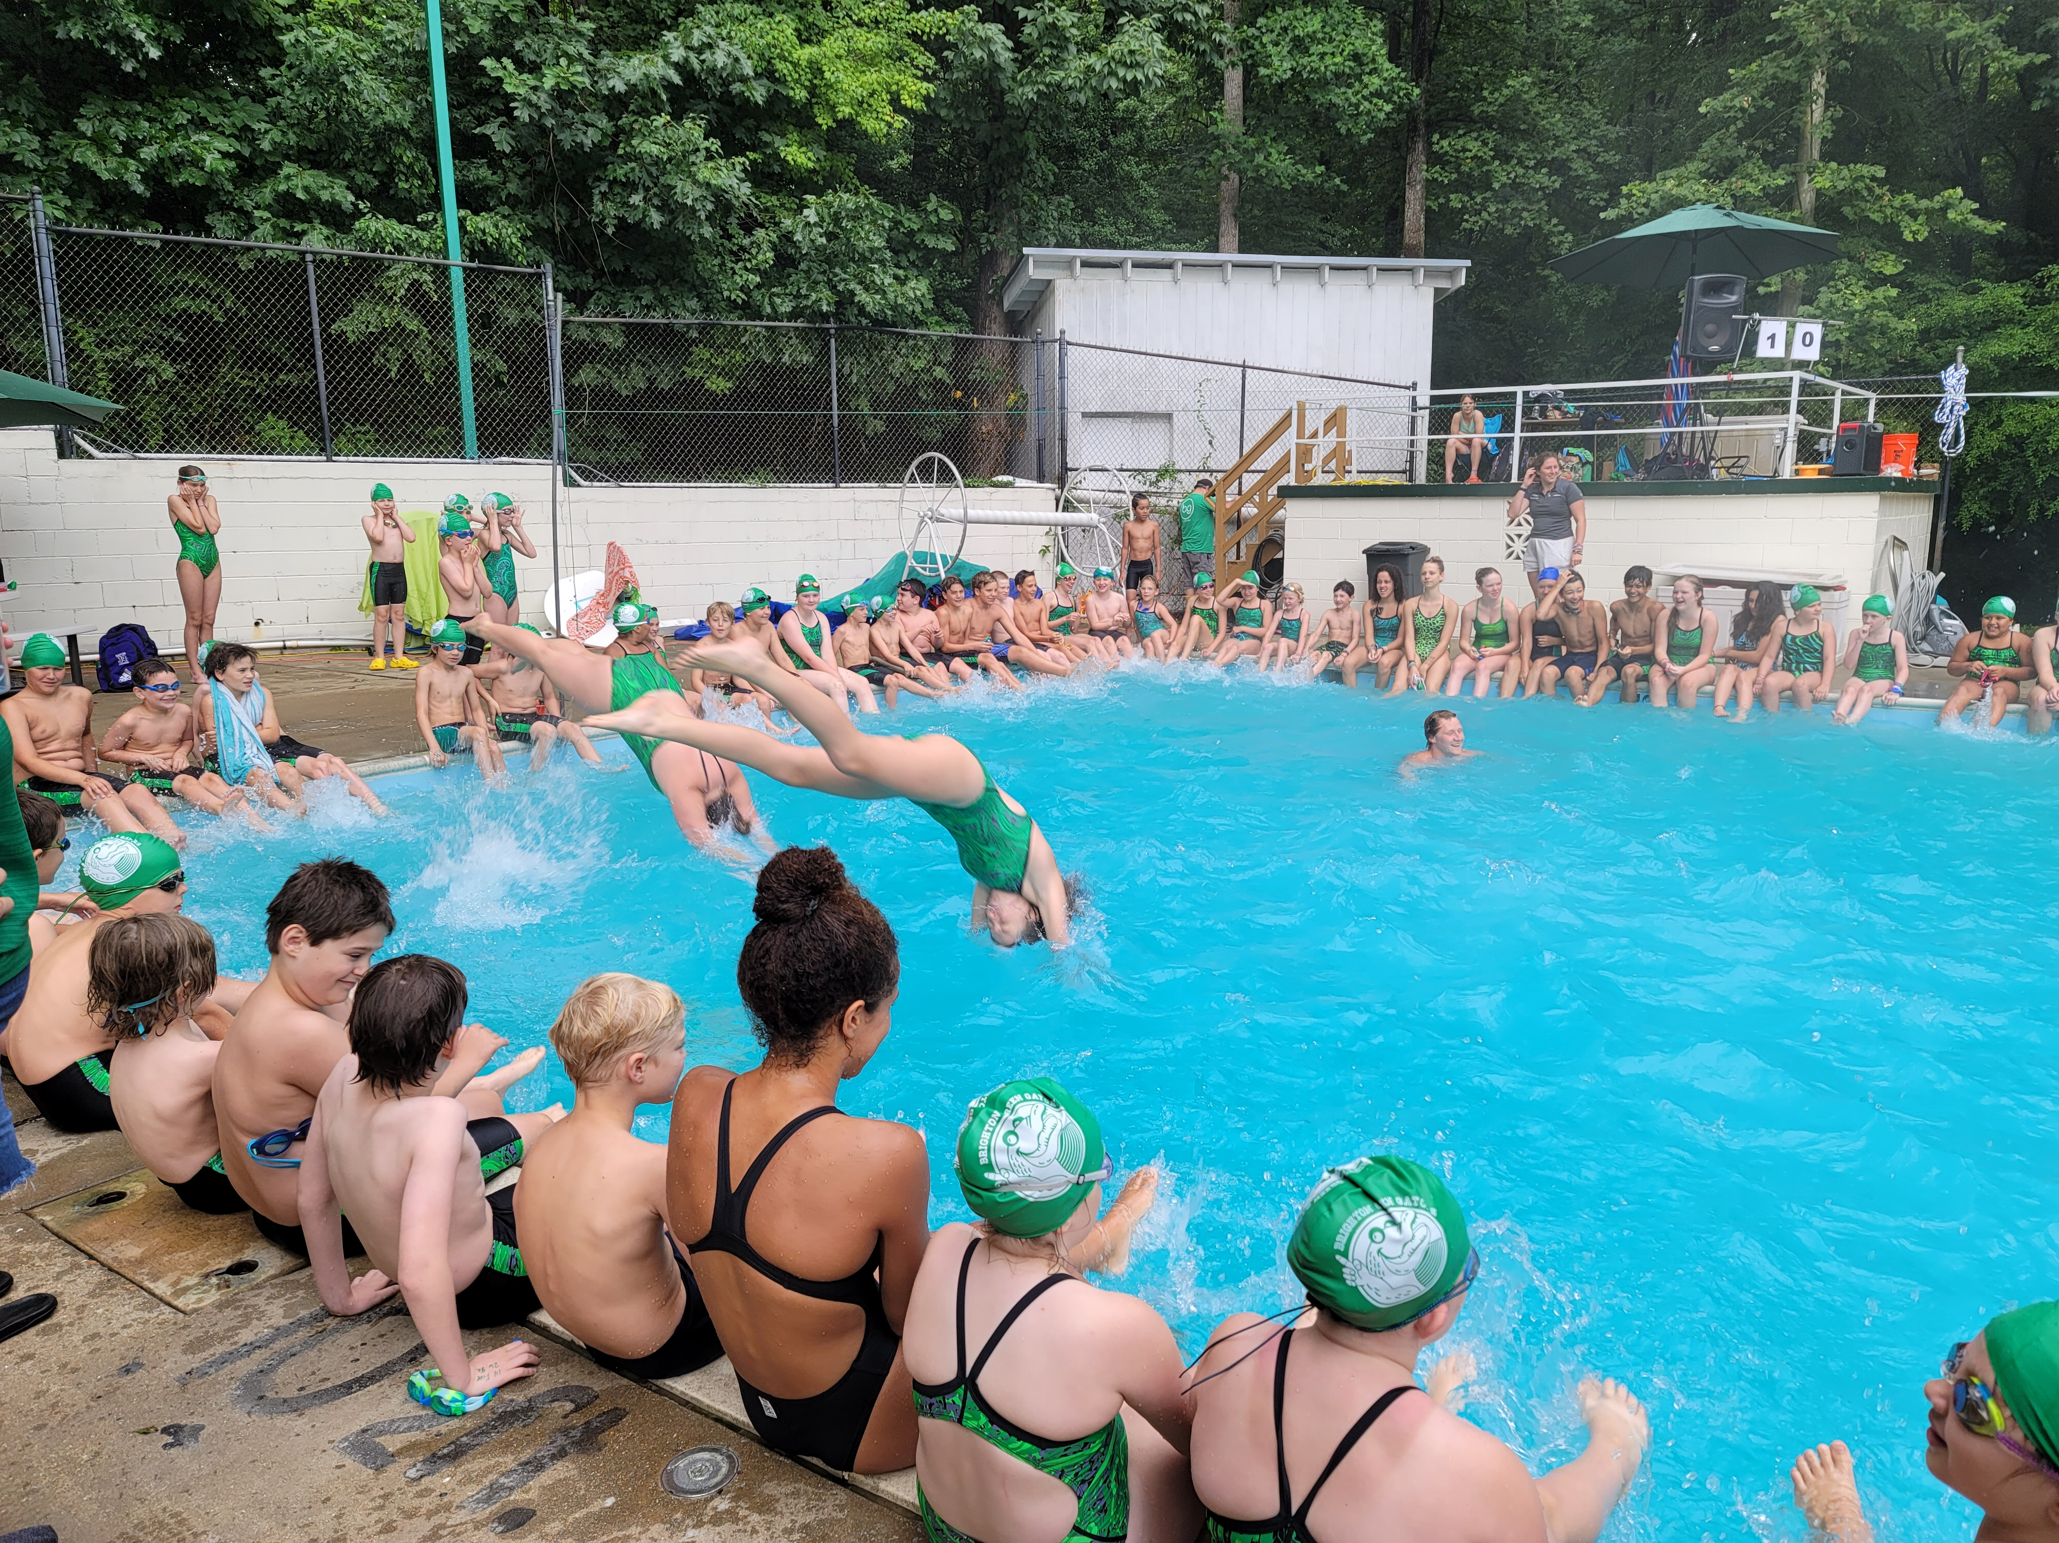
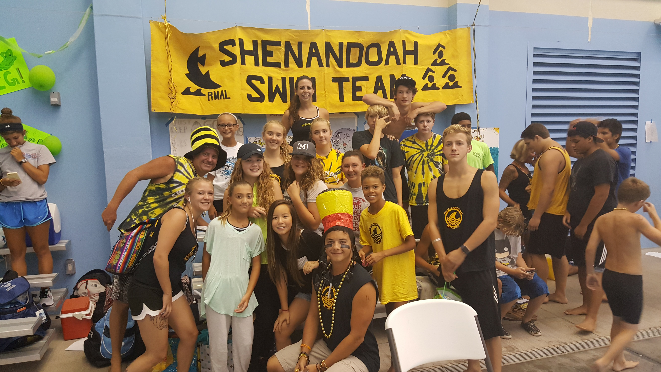
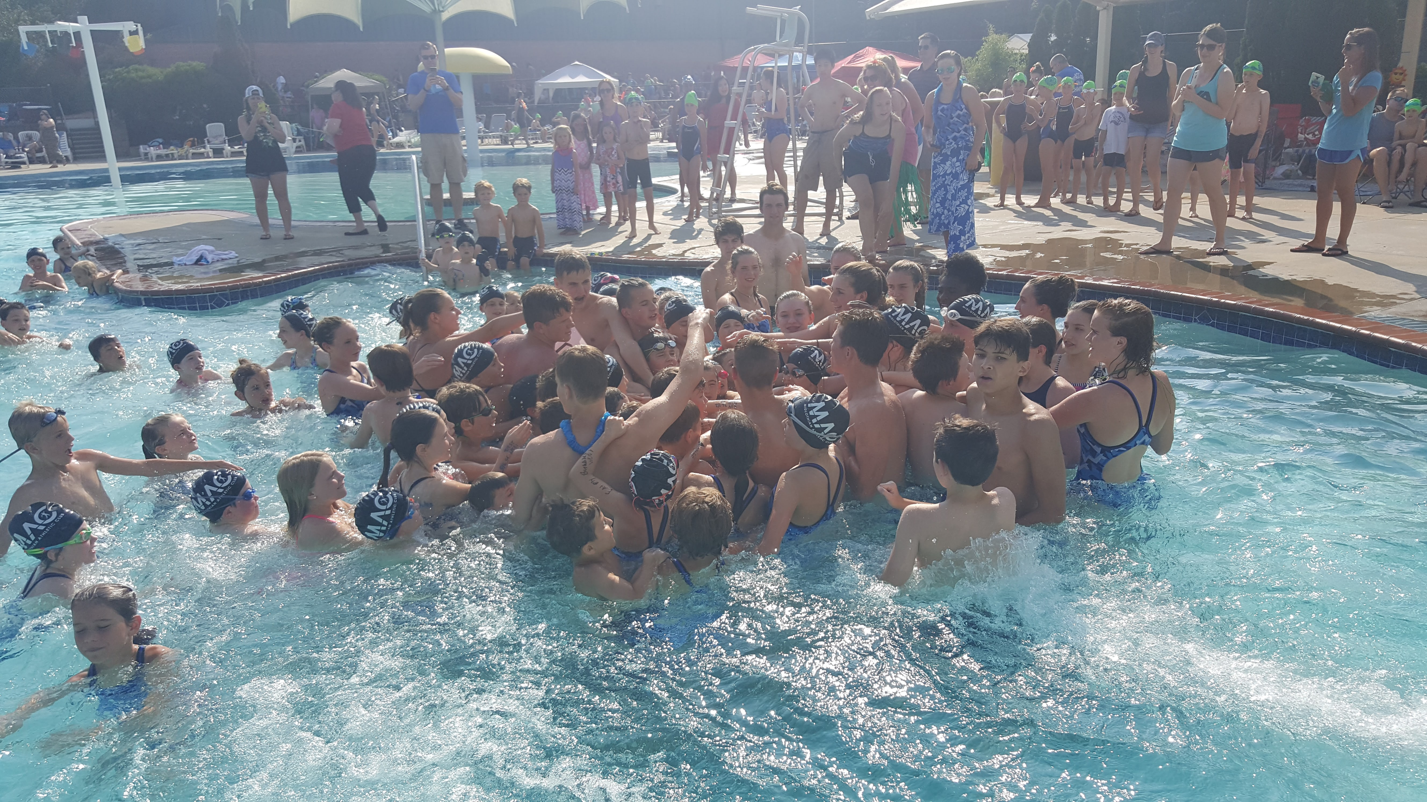
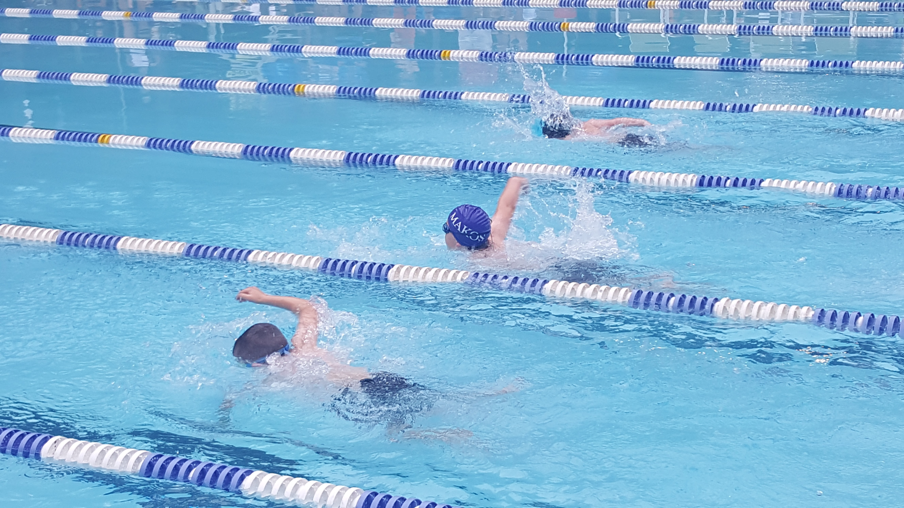
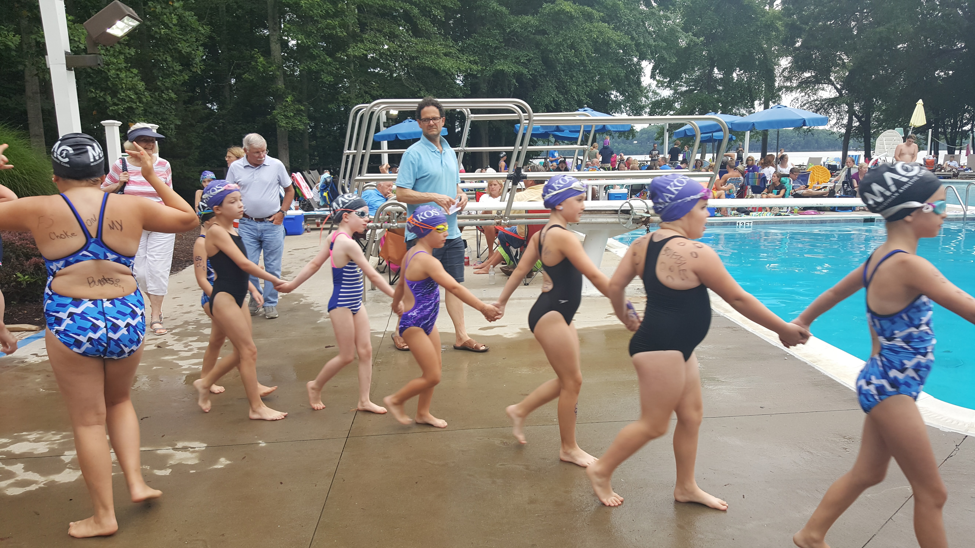
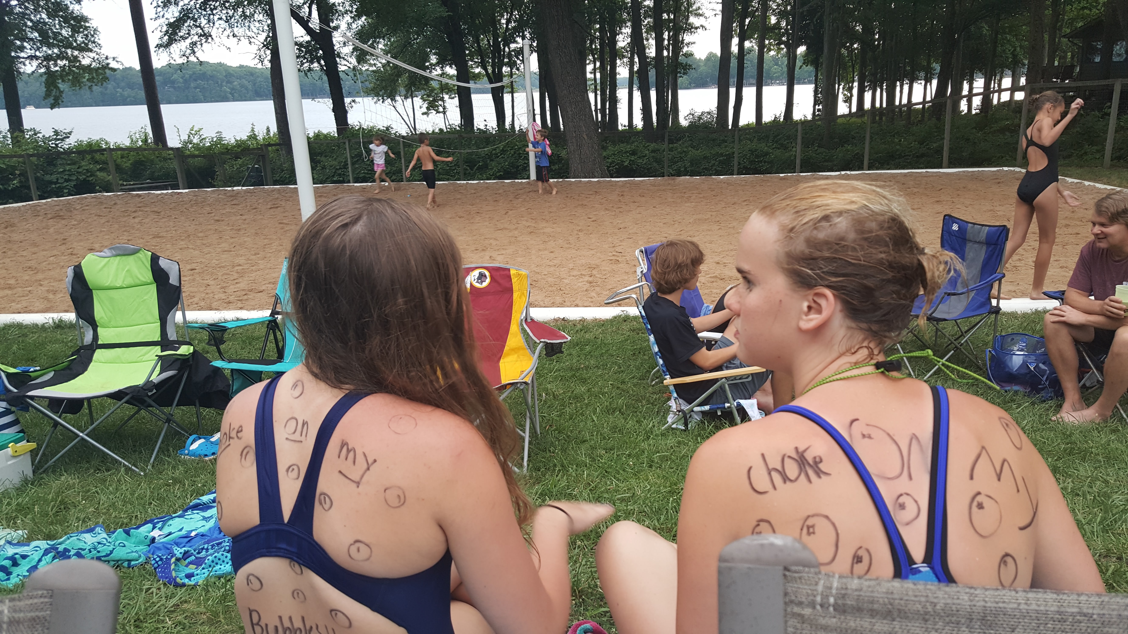
RMAL: A League of Neighbors

Slide 3
RMAL League Overview
Richmond Metro Aquatic League
Founded in 1974
Smallest league in the area with smallest footprint
2,000 swimmers
Comprised of 16 teams
ACAC Granite Stonehenge
Bon Air Greenfield Surreywood
Brandermill Midlothian Athletic Club Walton Park
Brighton Green Settlers Landing Willow Oaks
Charter Colony Shenandoah Woodlake
YMCA (Midlothian & Powhatan)

Slide 4
RMAL League Overview
The league functions like a federation with governance over competitive matters.
Guided by a group of elected officers whose main function is administrative
David Norman, President Adrienne Howlett, Treasurer Rob Schorr, At large
Todd McDermott, VP Georgann Wilkinson, Secretary Scott Soukup, At large
Michele Turlington, At large
Officers do not have voting privileges, team representatives vote, one vote per team
RMAL Board meets twice a year
3rd Wed. in March, spring meeting
3rd Wed. in October, fall meeting

Slide 5
Before the Season Starts Right Now!
Check team computers for Meet Manager and Team Manager
1st-Check team email for links
2^{nd-}Contact RMAL gmail
Check for access to Swim Manager
Contact support at Hy-Tek
hyteksupport@active.com

Slide 6
Before the Season Starts
Ensure that the league has correct contact information (name, email, cell) for:
Parent Reps.
Aquatic Directors
Head coaches (names only of assistants)
Meet Manager Volunteers
Head Refs.
Go to website and check your contacts and email league
Insert new waiver in Swim Manager, hard copies for other teams

Slide 7
Before the Season Starts Volunteers!
Assess and recruit key volunteers and communicate league training information to Strokes and Turns/Head Ref./Starter and Meet Manger Volunteers early and often
Meet Manager-at least 2
Strokes and Turns- 4-6 or more depending on team size
Head Ref-2
Starter-2
Announcer
Key Clerk of Course Volunteer
Head Timer

Slide 8
Volunteer Roster
Strokes and Turns Volunteer check-in
Head Ref Ribbon Labels (for after meet)
Starter Runners
Announcer Timers (3 per lane)
Meet Manager plus desk helpers 2 with Dolphins
Head Timer (Dolphin lead) 2 with stopwatches
Clerk of Course 1 scribe
6 and under helpers

Slide 9
Training Strokes and Turns
Volunteers watch videos on website prior to attending demonstration session.
Parent rep. stress importance of viewing video first.
Strokes and Turns
Training dates set and locations TBD
Strokes and Turns official should train each year
Head Ref
Starter
Training held in late May/early June

Slide 10
Training Meet Software and Timing System
Active Hy-Tek Products
Meet Manager
Software that imports meet entry files and accepts times from the Dolphin timers
Produces results and label file for ribbons
Team Manager (for coaches)
Software that creates roster, entry file, and holds swimmer times
Swim Manager
Team website platform for team sign up, volunteer sign up, payment, and communication
Dolphins – Colorado Timing System Product
The blue timers
Dolphin Timing Software

Slide 11
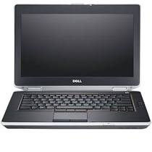
Swim Software
Results file to league
Results file to import to Team Manager
File for printing ribbon labels

Slide 12
Training Meet/Team Manager
Training will be provided for Dolphin and Meet Manager software
Each team should have a minimum of two volunteers train for Meet Manager
BEFORE DEMONSTATION SESSION: Volunteers view video and review materials in Meet Manager section of website (Parent reps. confirm)
Volunteers sign up for one of two demonstration sessions (sign-ups will be sent out)
June 2nd 7-9pm @ Granite
June 4th 10am-12pm @ Brighton Green
Make team laptops available for volunteers to bring to demonstration sessions
Team Manager training for coaches
Training provided to coaches prior to season start on an as-needed basis

Slide 13
Pre-season Dates
Training sessions
Communicate with first opponent and set first meet date
Equipment/ribbon/DQ slip and payment night – June 13th Brighton Green 7PM
Bring check for league fees/Venmo prior to attending/CC payment with fee
Fees for swimmers signed up so far
Rosters – hard copy or sent to League gmail
Hard copy waivers for teams not using Swim Manager must match roster #
Accept new swimmers up until day before 2nd meet
Teams with first meets retrieve equipment-equipment schedule pending
CHARGE THE STARTER!!!
All teams pick up ribbons and DQ slips

Slide 14
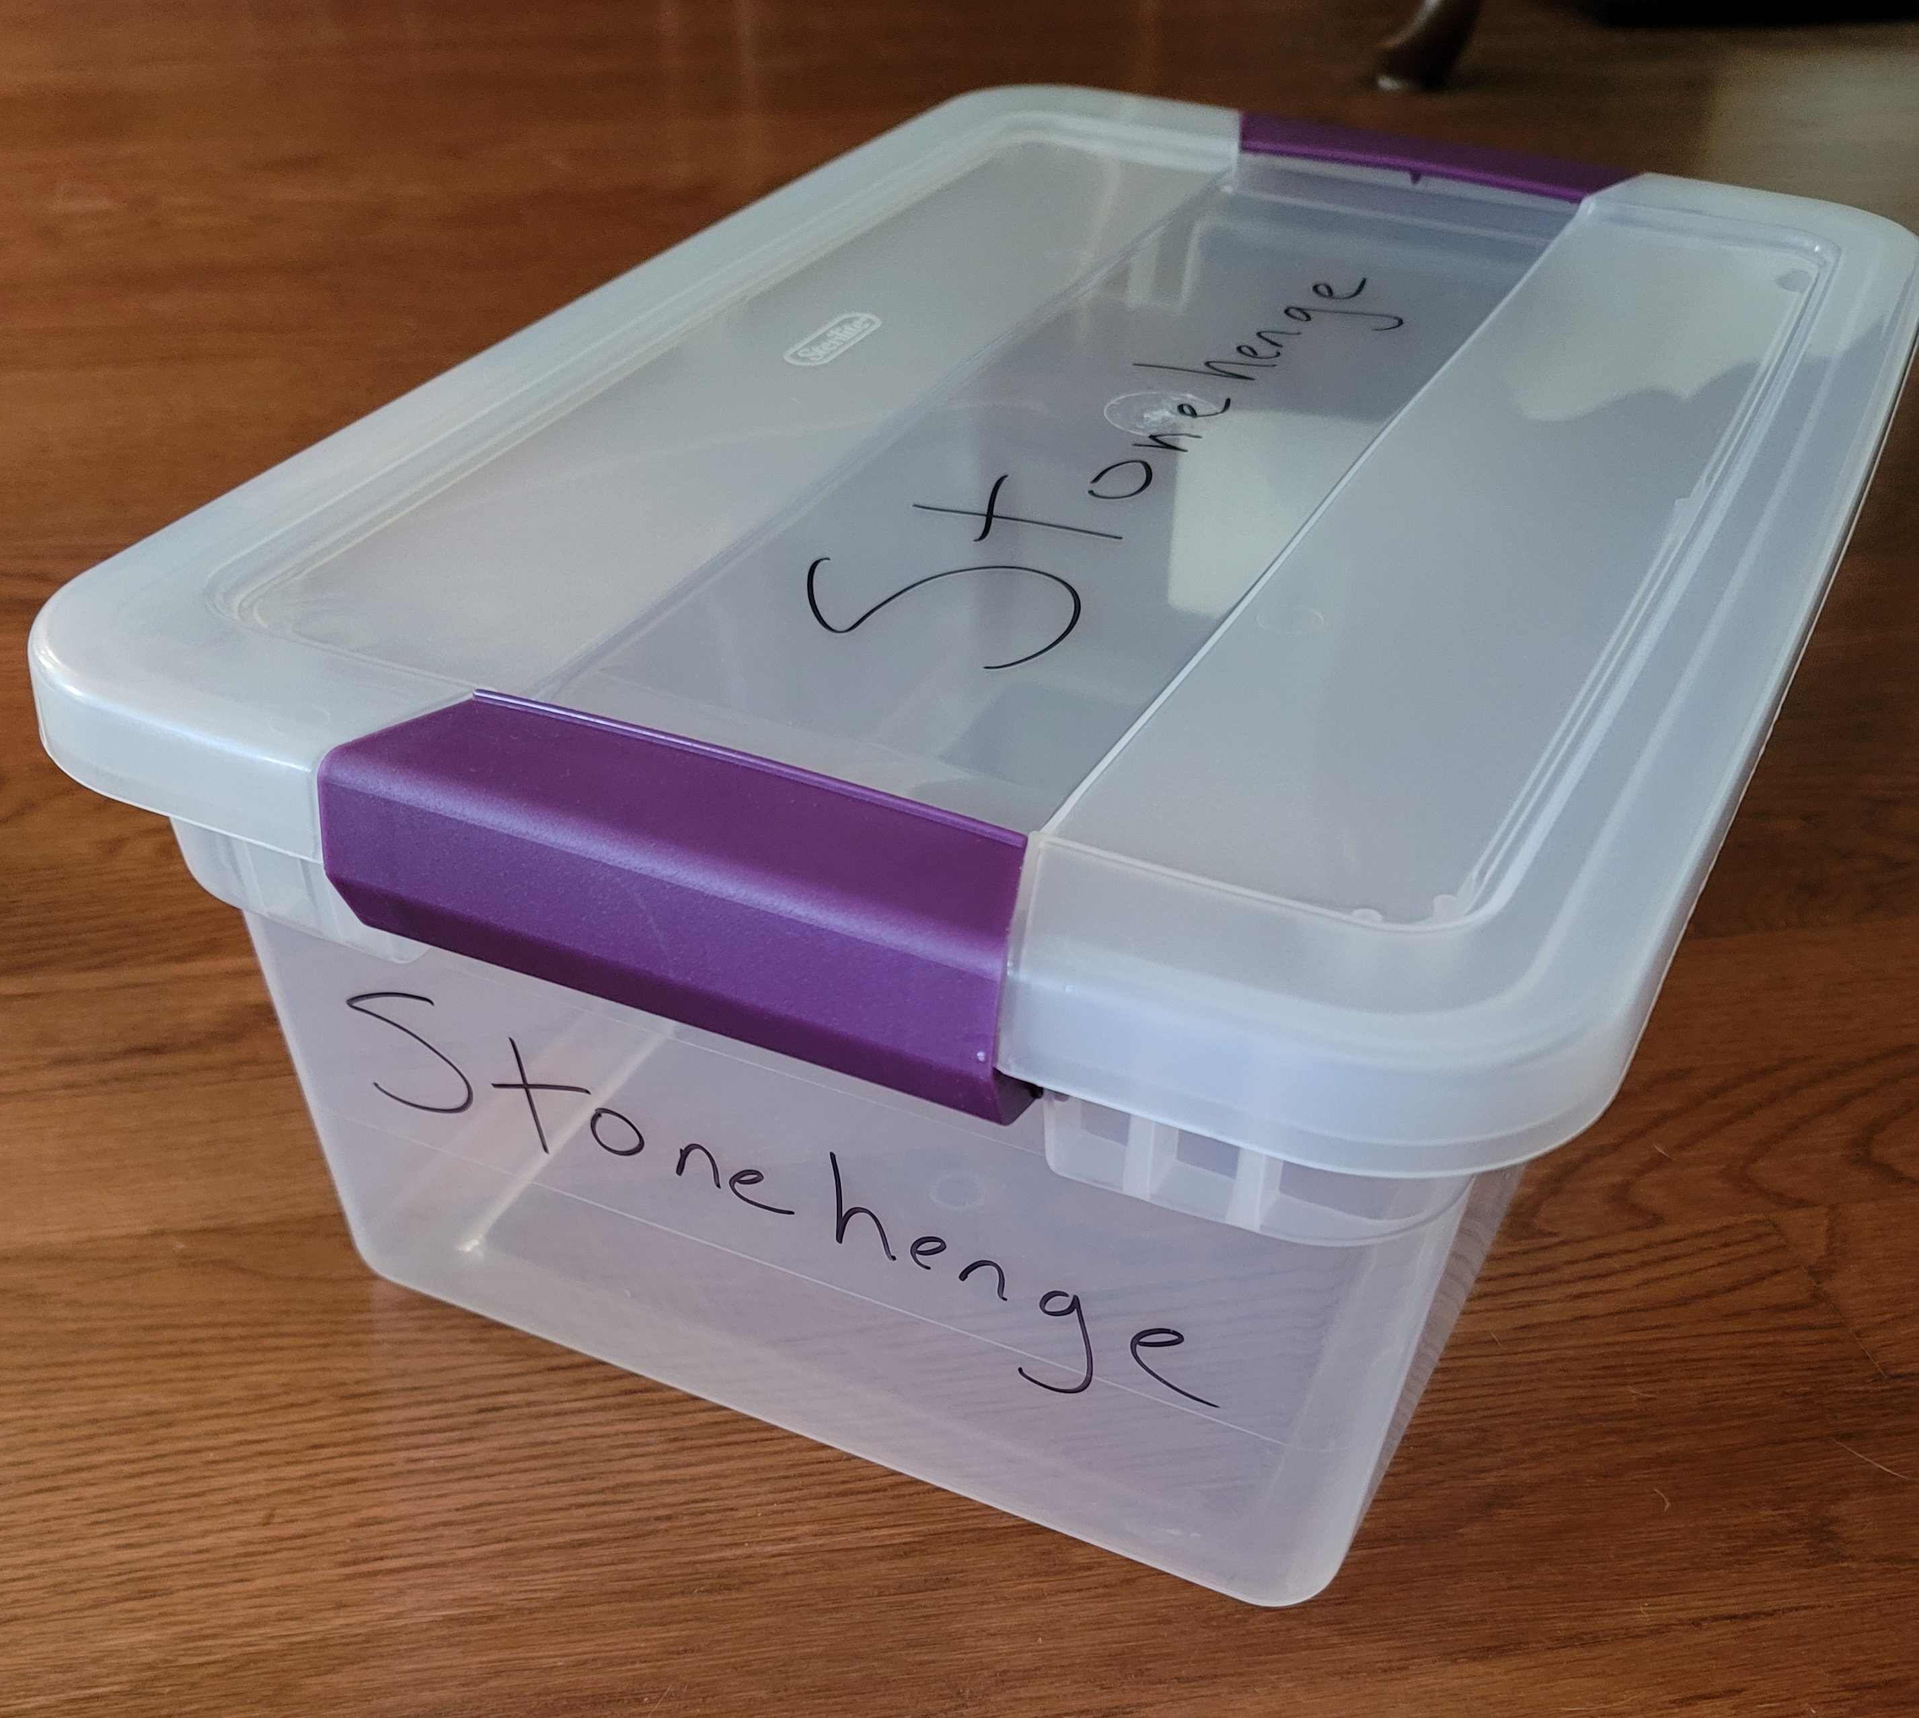
End-of-season Drop-off Week Before Champs
Equipment/extra ribbons/dq slip hand-in
Do not put rubber band or clips on ribbons
Champs fee payment
Additional swimmer fee payment (those that joined team after 1st payment)
Bring bin to this drop off for Champs ribbons and medals (15Q, 17”long)

Slide 15
RMAL Champs
RMAL Champs takes place at SwimRVA and this year on July 25th
Strive to have 24-32 swimmers per event or 3-4 heats per event
Goal – 40% of swimmers qualifying for Champs
Make a qualifying time
Coach selection
Champs qualifiers are closely monitored throughout the summer and qualifying times are lowered if needed to ensure our participation goal.
Board is actively working to increase Champs participation

Slide 16
Champs Overview Volunteers
4 weeks before Champs
Teams will receive Champs volunteer assignments
Assignments based on team size
Prepare for Champs by training volunteers now
Tuesday before Champs
Volunteer names and contact information due to league
Require the name and contact information of at least one team lead at all times at Champs
Consider out of the box solutions to filling volunteer positions
Offer volunteer hours to older teens for positions like 6 and under helpers
Use extra assistant coaches in Clerk of Course area and 6 and under helpers

Slide 17
Champs T-Shirts
The league’s primary annual fundraiser and extremely popular with swimmers
Raises over $3,000 each year, enough to pay for a timing system
Purchased through a local vendor, Corporate Imprints, with tight turnaround
Online shop
Will close shop earlier this year due to supply chain issues
Please send related messages to your swimming families immediately and often
Pre-paid shirts delivered to Champs, set up in concessions, and are picked by purchaser

Slide 18
Senior Recognition at Champs
List of your graduating seniors for recognition at Champs
Seniors from class 2022
A short bio of each senior
College
Swimming in college
Major
Year-round team
How long with your team, thanks, other short info
Picture of the seniors on your team together in jpg via email (optional)
One picture per team, only a picture, ATTACHED to email

Slide 19
Information/Assistance
League website: https://www.swimrmal.org/
Rulebook
Team contacts
Schedules
Job postings
League email: rmalswim@gmail.com
League Facebook page: https://www.facebook.com/groups/RMALSwimming

Slide 20
For Discussion: Pre-meet Communication
How does your team communicate with the opposing team prior to meets?
Team contacts are listed on RMAL website under each team.
Volunteer allotment is outlined in RMAL Rule Book.
Each team is responsible for bringing stopwatches to home and away meets.
Divisions A and B teams should each bring ten stopwatches to home and away meets.
Division C teams should each bring eight stopwatches to home and away meets.

Slide 21
Pre-meet Communication

Slide 22
For Discussion: Fundraising Ideas
T-shirt sales
Walton Park-Sponsor a Bench Fundraiser
Free Membership Raffle
Swim-a-thons
50/50 Raffles
Sponsors for Home Meets
Advertising on Webpage/Donate a Banner
Parent Spiritwear

Slide 23
For Discussion: Keeping Older Swimmers Interested
How does your team work to retain older swimmers?
Involve older swimmers in junior coach roles, recognize them at the end of the season, small gift, training for future coaches
Reduced rate
Building relationships between coaches and swimmers
Establish a mentor program pairing younger swimmers up with older swimmers

